Slide 1
Notes on Research

Slide 2
Caveat
There is no one way to do research, no silver bullets
Instead: General strategies
General resources at the end
Building Foundations | Research Practice | Picking Problems
Reading (widely) Programming | Reading (in-depth) Writing regularly Problem solving & Experiments Learning from others | Considerations to keep in mind Updating direction
Notes:
I don’t think there are any secrets to doing research (let me know if you know any!)

Slide 3
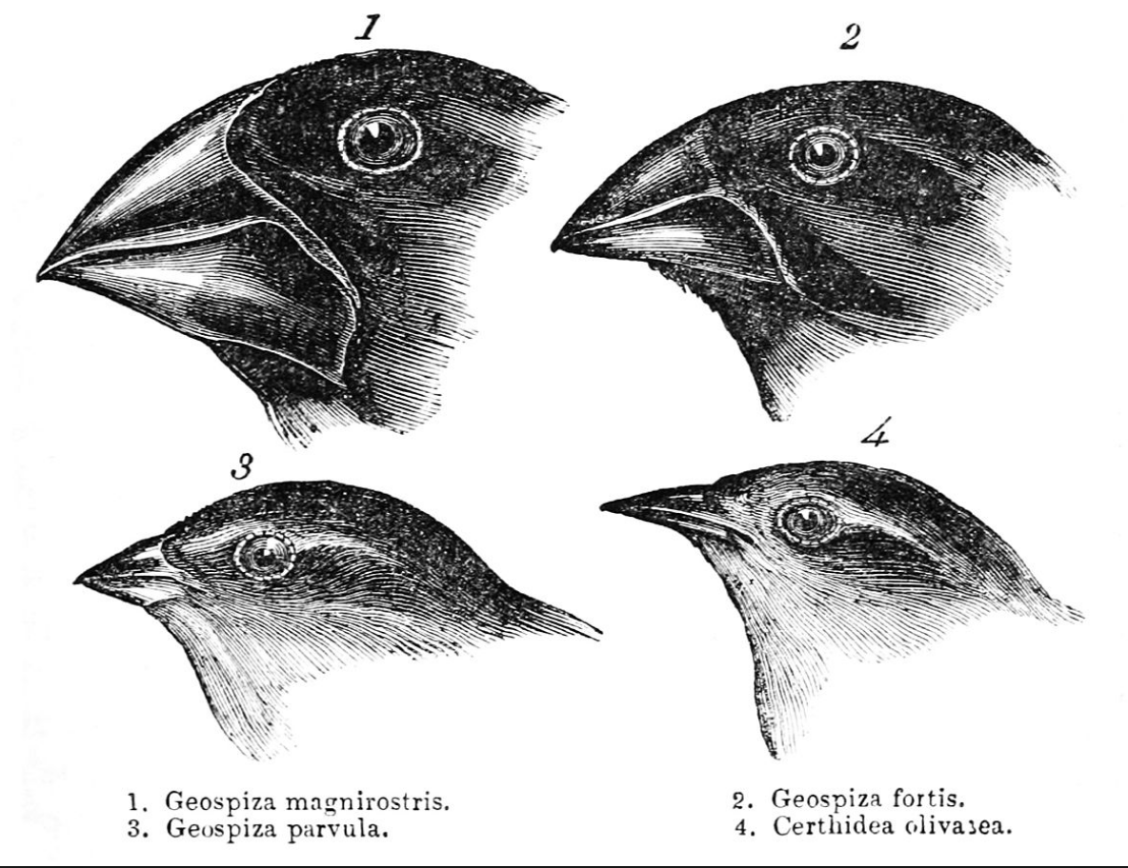
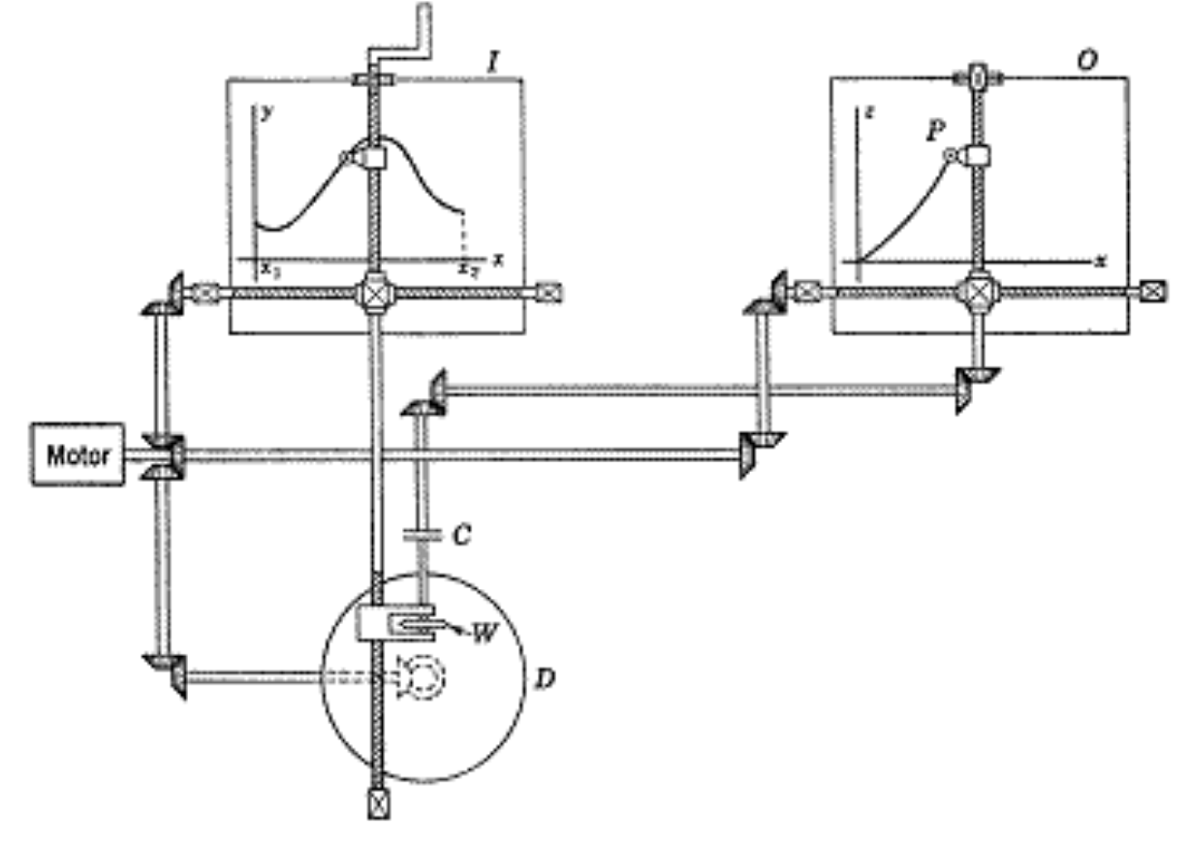
What is research, even?
Explaining things | Improving problem-solving
What is and isn’t known? Can you help so more becomes known? | Solutions for problems beginning to emerge Streamline solutions to recurring problems People in the future will depend on our community’s efforts
Notes:
It’s not just development → development projects have clear ways forward (and no risk)

Slide 4
Foundations: Reading
Understanding
Find concrete examples
Draw pictures
Articulate what you don’t understand (a definition, an argument, ...)
Engaging
Summarize contributions. Does it live up to claims?
Reconstruct authors’ thought process.
Can you apply it to your problems?

Slide 5
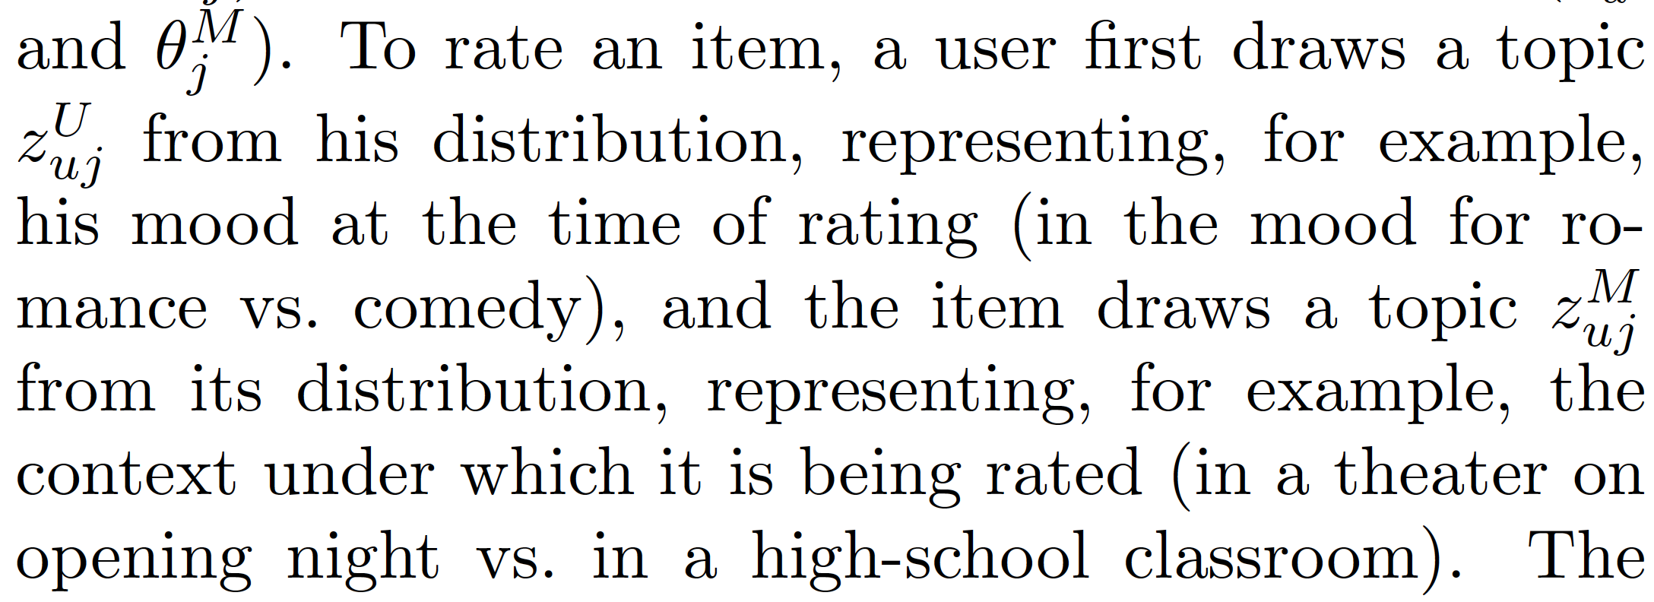
Foundations: Reading
Understanding
Find concrete examples
Draw pictures
Articulate what you don’t understand (a definition, an argument, ...)
Engaging
Summarize contributions. Does it live up to claims?
Reconstruct authors’ thought process.
Can you apply it to your problems?
Sometimes, the authors give us examples, (like this one from Mixed-Membership Matrix Factorization), other times we have to make one up ourselves.

Slide 6
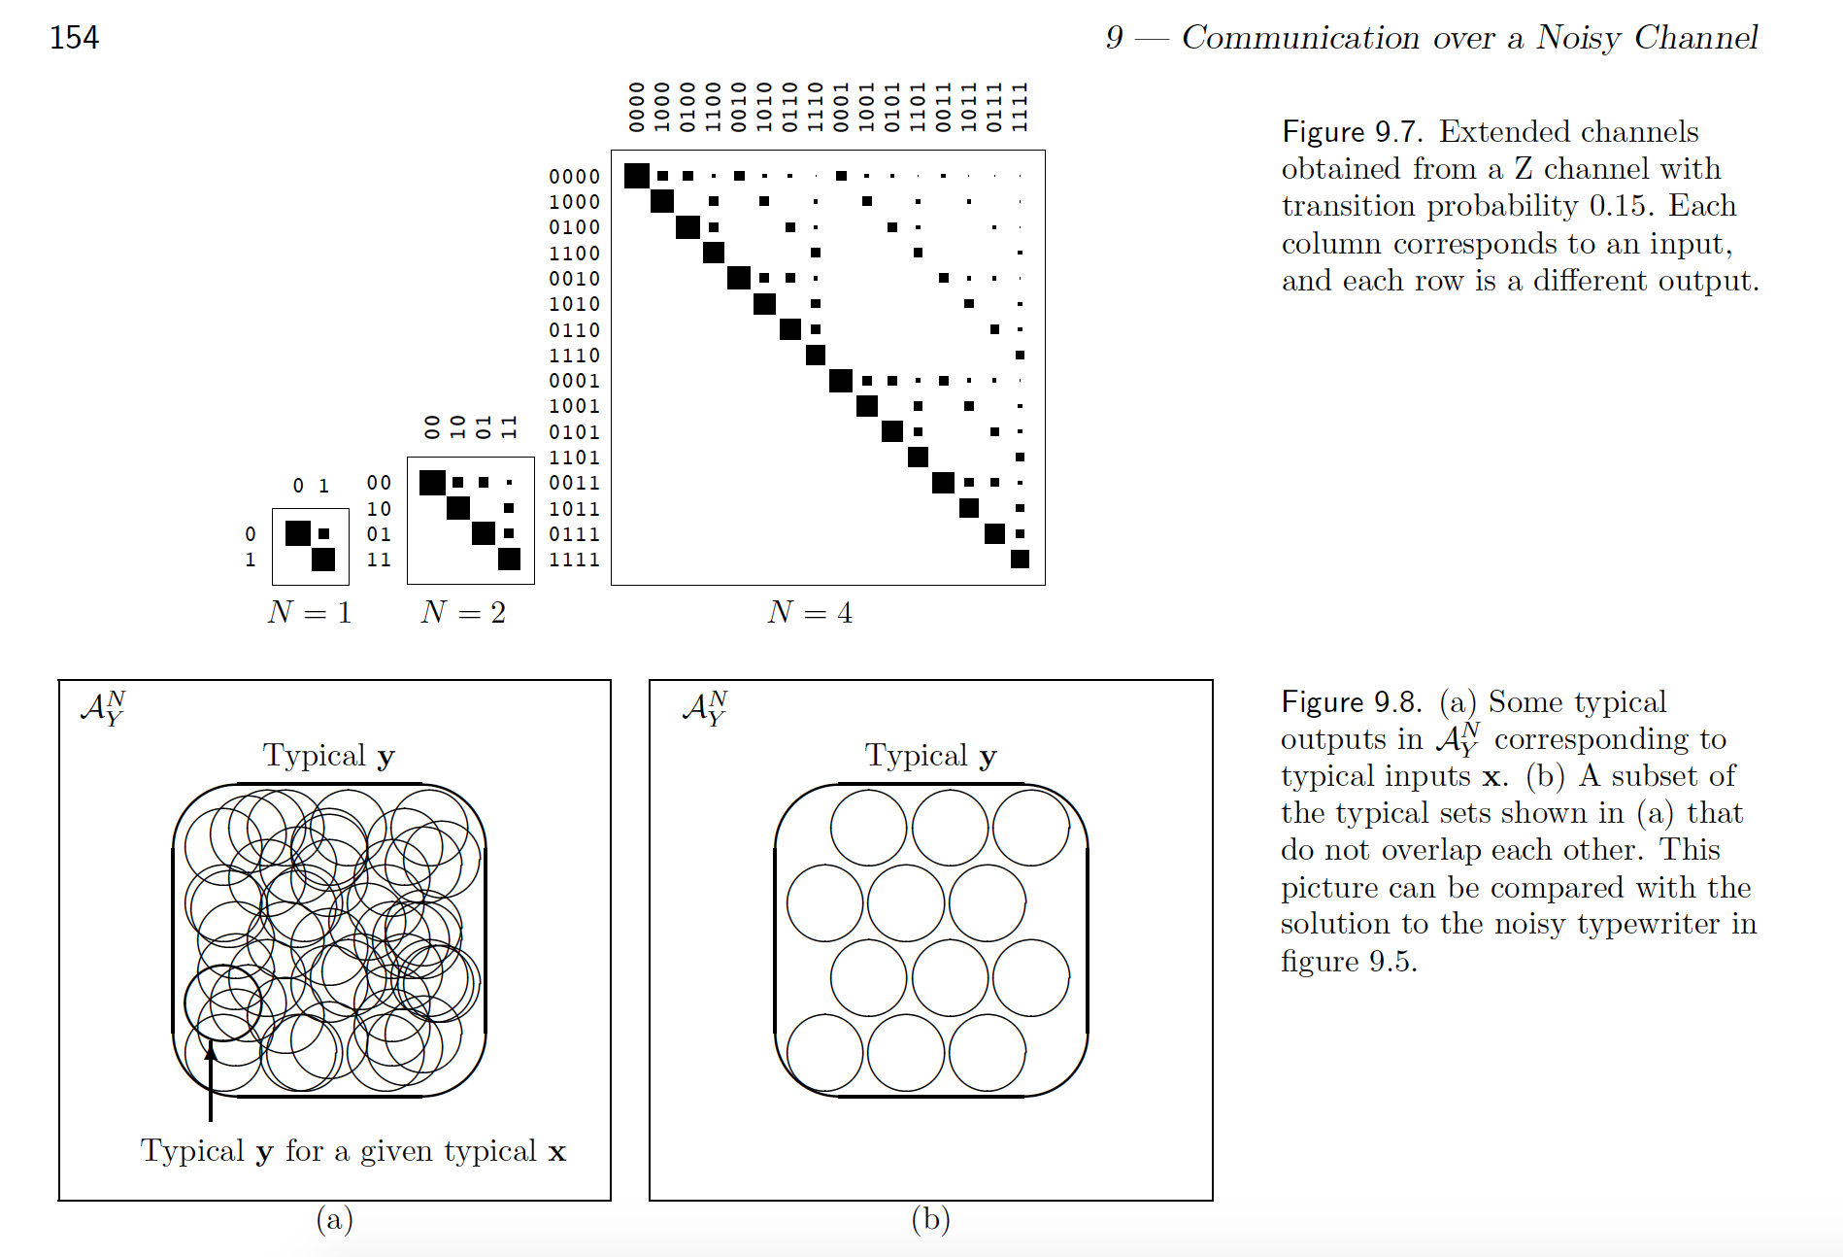
Foundations: Reading
Understanding
Find concrete examples
Draw pictures
Articulate what you don’t understand (a definition, an argument, ...)
Engaging
Summarize contributions. Does it live up to claims?
Reconstruct authors’ thought process.
Can you apply it to your problems?
(example from David Mackay’s Info Theory book, free online.)

Slide 7
Foundations: Reading
Understanding
Find concrete examples
Draw pictures
Articulate what you don’t understand (a definition, an argument, ...)
Engaging
Summarize contributions. Does it live up to claims?
Reconstruct authors’ thought process. What are they trying to do?
Can you apply it to your problems?

Slide 8
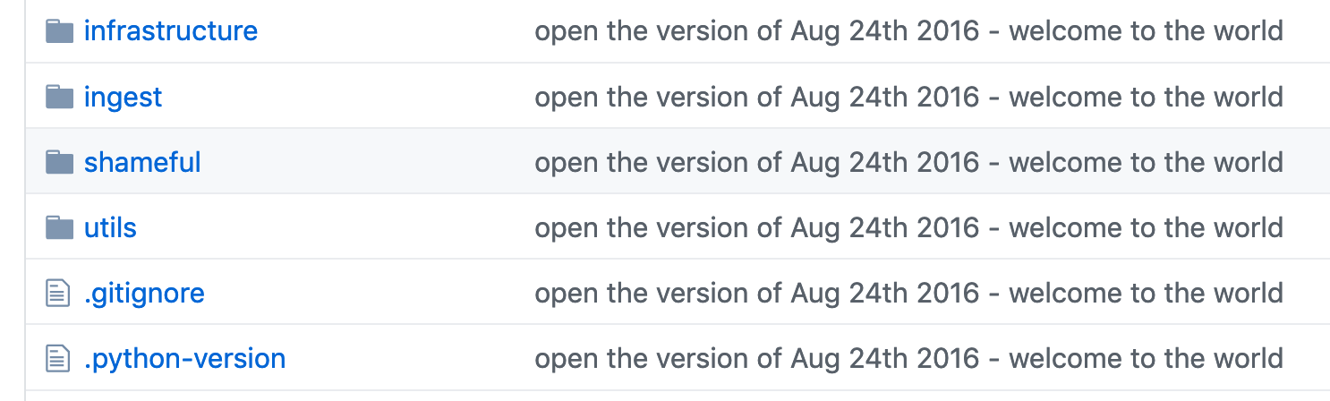
Foundations: Programming
Create short exercises (get at the ideas)
Read other peoples’ code!
  Good and bad...
Maybe best way to learn good code style is to try to navigate incomprehensible code.
Example from my Sedesol project repo.

Slide 9
Research Practice

Slide 10
Reading for Research
Ask around for recommendations, libraries are too big
Knowing great papers in depth > reading a gazillion of average ones
There are no distinct “learning” and “research” phases
Engagement is especially important here
Reading and research are not distinct phases!

Slide 11
Reading for Research
Ask around for recommendations, libraries are too big
Knowing great papers in depth > reading a gazillion of average ones
There are no distinct “learning” and “research” phases
Engagement is especially important here
“If you wait to master one topic before moving on to the next, you'll never get anywhere”
Ravi Vakil’s advice
Reading and research are not distinct phases!
Notes:
The lines should actually be exponential.

Slide 12
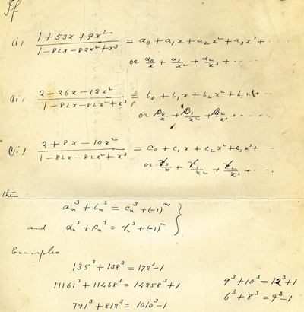
Writing: Lab Notebook
Fragments of
  Summarized readings
  Examples you like
  Problems you care about
  Ideas you come up with
Even geniuses need to tinker!

Slide 13
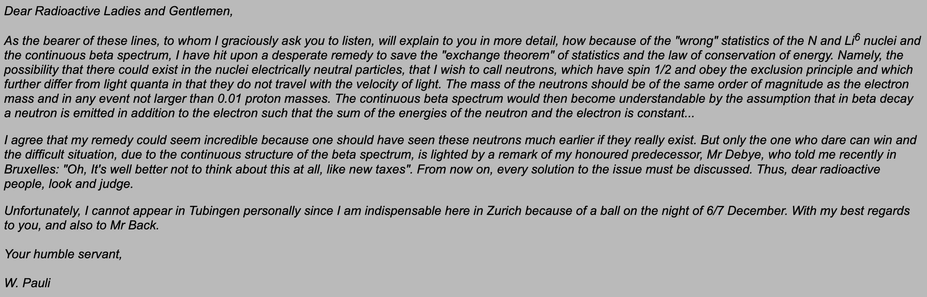
Writing: Lab Notebook
Write informally (letters to self)
Review periodically (can suggest architecture for papers)
I wonder whether the best medium for research are letters.

Slide 14
Problem Solving and Experiments
Two modes: Brainstorm and Critique
  Need to be able to tolerate ambiguity
Imagine possible experiment outcomes
Try articulating ideas as they come up
Brainstorm
Critique
Notes:
Basic idea throughout: Engage yourself in problem solving, more than just doing work.

Slide 15
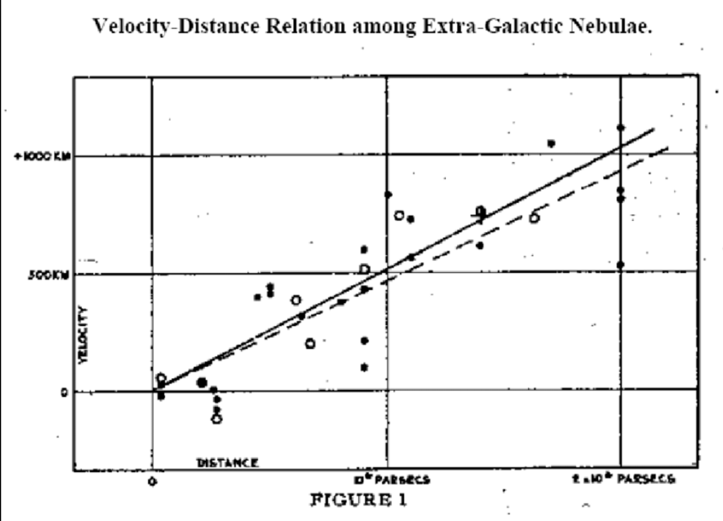
Problem Solving and Experiments
Two modes: Brainstorm and Critique
  Need to be able to tolerate ambiguity
Imagine possible experiment outcomes
Try articulating ideas as they come up
What figures will you draw?
What conclusions might they suggest?
Notes:
Basic idea throughout: Engage yourself in problem solving, more than just doing work.

Slide 16
Problem Solving and Experiments
Two modes: Brainstorm and Critique
  Need to be able to tolerate ambiguity
Imagine possible experiment outcomes
Try articulating ideas as they come up
Ideas should lead to falsifiable claims.
“New Model will learn from imperfect labels, while Old Model will not.” → Falsifiable
“New Model is really awesome” → Not falsifiable
Notes:
Basic idea throughout: Engage yourself in problem solving, more than just doing work.

Slide 17
Writing and Sharing
Sketch papers before ideas are fully-formed
Get feedback from others
Research is a conversation, papers are the units of exchange
Gap: Thing we don’t know / don’t know how to do easily
Idea: What should we do about it?
Experimentation: How will you evaluate? What figures to make?
Interpretation: What can you conclude, and what’s next?

Slide 18
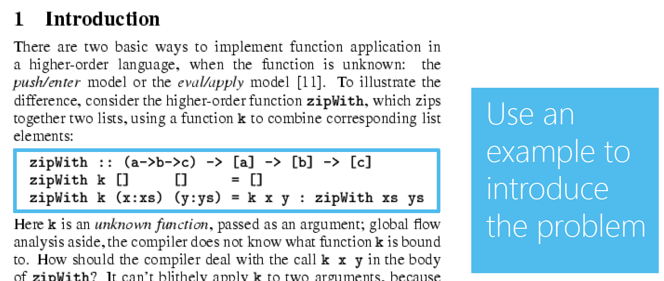
Writing and Sharing
Sketch papers before ideas are fully-formed
Get feedback from others
Research is a conversation, papers are the units of exchange

Slide 19
Writing and Sharing
Sketch papers before ideas are fully-formed
Get feedback from others
Research is a conversation, papers are the units of exchange
From the “How to do research at the MIT AI Lab” Working Paper (1988)

Slide 20
Picking Problems

Slide 21
Inspiration
Big picture reviews (my biases)
  Computational Sustainability for the Developing World
  Representation Learning: A Review and New Perspectives
  Artificial Intelligence — The Revolution Hasn’t Happened Yet
  A Statistical View of Deep Learning
Keynotes and panels (especially workshops)
  Schedule / recordings often available online [icml, kdd]
Past consultation projects
  What problems do you find yourself doing over and over?
Notes:
Workshop keynotes tend to be more tailored to particular interests.

Slide 22
Inspiration
Big picture reviews (my biases)
  Computational Sustainability for the Developing World
  Representation Learning: A Review and New Perspectives
  Artificial Intelligence — The Revolution Hasn’t Happened Yet
  A Statistical View of Deep Learning
Keynotes and panels (especially workshops)
  Schedule / recordings often available online [icml, kdd]
Past consultation projects
  What problems do you find yourself doing over and over?
Asking the right questions is an important, but learnable skill.
Notes:
Workshop keynotes tend to be more tailored to particular interests.

Slide 23
Tensions
Personal vs. Community
  Reflect on personal, “bluesky” problems
  But make sure *someone* cares about your problem
  Feedback on quick prototypes helps avoid wasted time
Big vs. small problems
  Life is short, work on important problems!
  *But*
    (1) need a starting point and
    (2) don’t lose joy in small, beautiful ones
Notes:
Anticipate future research progress
Get feedback, but maintain vision

Slide 24

Tensions
Personal vs. Community
  Reflect on personal, “bluesky” problems
  But make sure *someone* cares about your problem
  Feedback on quick prototypes helps avoid wasted time
Big vs. small problems
  Life is short, work on important problems!
  *But*
    (1) need a starting point and
    (2) don’t lose joy in small, beautiful ones
What might the future look like?
What does the future need?
Notes:
Anticipate future research progress
Get feedback, but maintain vision

Slide 25
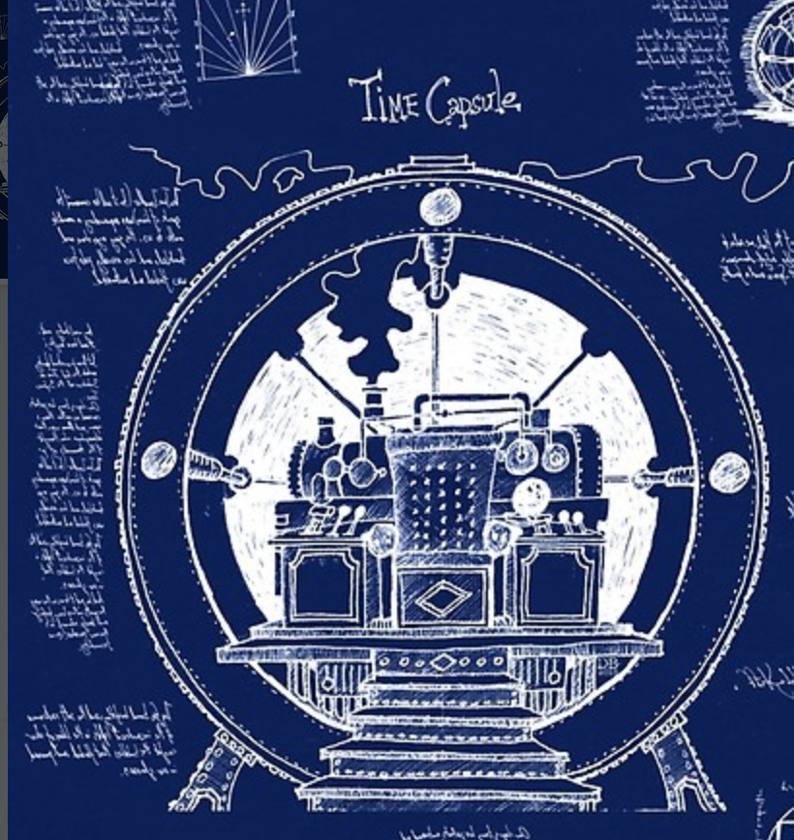
Tensions
Personal vs. Community
  Reflect on personal, “bluesky” problems
  But make sure *someone* cares about your problem
  Feedback on quick prototypes helps avoid wasted time
Big vs. small problems
  Life is short, work on important problems!
  *But*
    (1) need a starting point and
    (2) don’t lose joy in small, beautiful ones
We don’t do research on building time machines, as cool as they would be. Problem needs to be “ripe” for solving (but not the target of big players)
Notes:
Anticipate future research progress
Get feedback, but maintain vision

Slide 26
Tensions
Personal vs. Community
  Reflect on personal, “bluesky” problems
  But make sure *someone* cares about your problem
  Feedback on quick prototypes helps avoid wasted time
Big vs. small problems
  Life is short, work on important problems!
  *But*
    (1) need a starting point and
    (2) don’t lose joy in small, beautiful ones
Pose simple questions that articulate concrete features of the phenomena of interest.
J. Michael Steele’s Rants.
Notes:
Anticipate future research progress
Get feedback, but maintain vision

Slide 27
Worthwhile problems
Reflect frequently on important problems....
But don’t blind yourself to the worthwhile ones
“No problem is too small or too trivial if we can really do something about it.”
From a wonderful letter by Richard Feynman to Koichi Mano.
Notes:
We don’t live long, try to contribute to problems truly worth solving.

Slide 28
Worthwhile problems
Reflect frequently on important problems....
But don’t blind yourself to the worthwhile ones
“No problem is too small or too trivial if we can really do something about it.”
From a wonderful letter by Richard Feynman to Koichi Mano.
Notes:
We don’t live long, try to contribute to problems truly worth solving.

Slide 29
Resources
How to do research at the MIT AI Lab
Graduate Study in the Computer and Mathematical Sciences: A Survival Guide
How to have a bad career in research
How to write a great research paper
Ravi Vakil’s advice
J. Michael Steele’s rants
You and your research
Worthwhile Problems
Notes:
We don’t live long, try to contribute to problems truly worth solving.

